Slide 1
A seminar presentation on cloud based inventory management system for maker space of sandip TBI BY 1. Mayuri v. burkul (be-A) 2. MRUNALI S. PAWAR (be-A) 3. SIMRAN B. SARKATE (BE-A) GUIDED BY Prof. Dr. Mrs. G. M. PHADE

Slide 2
index
Project overview
Problem statement
Block diagram
Algorithm
Project details
Methodology
Project requirement
Literature survey
Outcome of literature survey
Reference

Slide 3
Project overview
Introduction:
In this project we are going to develop an android application. the application will list all the existing component of department like resistor, capacitor, modules, any circuit board etc. and can be updated as required. the application will allow the user in our case students of department to take overview of component that department has to offer. the student can request for any component as per their requirement in application.
The admin of application has authority to accept request of student and allot the component. the admin only will have authority to accept request and to monitor the status of any component. The application will also highlight the Due date, so that the student can easily return or extend it due date.

Slide 4
problem statement
It is difficult to maintain an on-paper record of components inventory and updating it as it grows, also after issuing of components it becomes difficult to maintain the record.
Student face the problem to find the components and they don’t know which components are available in the department. And which new components are available in the department.

Slide 5







block diagram
Component issued by student
Due
Date
Admin
Add
Component
Login
Logout
Due
Date
Student
Search Component
Issue
Component

Slide 6
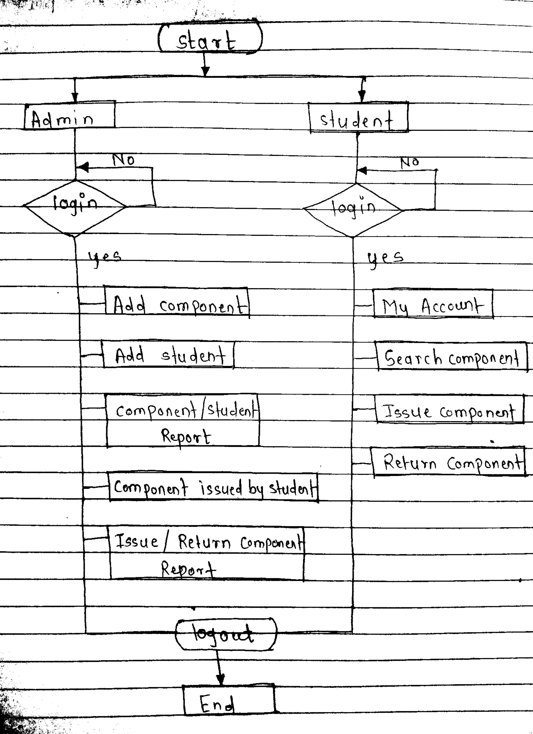
Algorithm

Slide 7
project details
We will design the cloud based application which is going to store the data about components available in the department.
Admin will be able to add new components in the data base.
The student details visible to the admin. Which student using the component and what is his/her timeline.
All students and admin are able to see the components available in the department.

Slide 8
Building a component library
Data collection:- admin will add all available components to the component library.
library status:- shows status of an components available in the department.
Login :-
a). Admin login :- user I’d - password – add components to the library – components issued by students.
b). Student login:- user I’d - password – components available in the library.
User requirement :- issue request as per component availability status – notification to the admin.
Updating of library status:- admin will be able to add new components to the available in the department.

Slide 9
project requirement
System required:- windows/ Linux system.
Software required:- VS code studio, android studio, android and flutter SDK.
Database:- Firebase
UI:- Flutter

Slide 10
LITERATURE SURVEY
SR NO | TITTLE | YEAR | AUTHOR NAME | OUTCOME | DRAWBACKS
1 | Fast book finding | 2007 | Curron & Potter | Locate and manage library materials | Authorizations of library System is limited.
2 | Efficient shelf management service | 2008 | Butters | Easy to manage huge number of books | Limited number of users can access at any instant of time
3 | Self service | 2010 | Muadhu sudhan | Faster circulation and supports reservation enquires | Number of components is restricted due to overburden to server.
4 | Security levels | 2012 | Abdou | Increased security of books | User counts is also limited for smooth functioning of system.

Slide 11
OUTCOME OF LITERATURE SURVEY
Enhancing the throughput of the system (I.e., smoothing function of system)
Implementing effective UI for user
Adding multiple security level to system (i.e., user privacy)
Single stroke search interface.
High degree of compatible in context of operability.

Slide 12
REFERENCE
Xiajun Jing, Peng Tang. Research and Design of the Intelligent Inventory Management System Based on RFID in 2013 Sixth International Symposium on Computational Intelligence and Design. DOI 10.1109/ISCID 2013.117.pp.8-11.
S. Jayanth, M.B. Poorvi, M.P. Sunil, Inventory Management System using loT in Springer Science+Business Media Singapore 2017.pp. 201-210.
Pag Singh2005 Inventory and Working Capital Management-Arn Em pinical Analysis, The ICFA Journal of Accounting and Research, Vol.VIL, NO.2,
Fowe Stene, Forence Memba2015-16 The Elect of invertory Manage ment or Profitability of Cement Manufacturing Companies in Kenya: A Case Stucy of Listed Comand Manufacturing Companies in Kery International Journal of Management and Commerce Innovations Val J, bs. 2, pp 111 110

